Slide 1
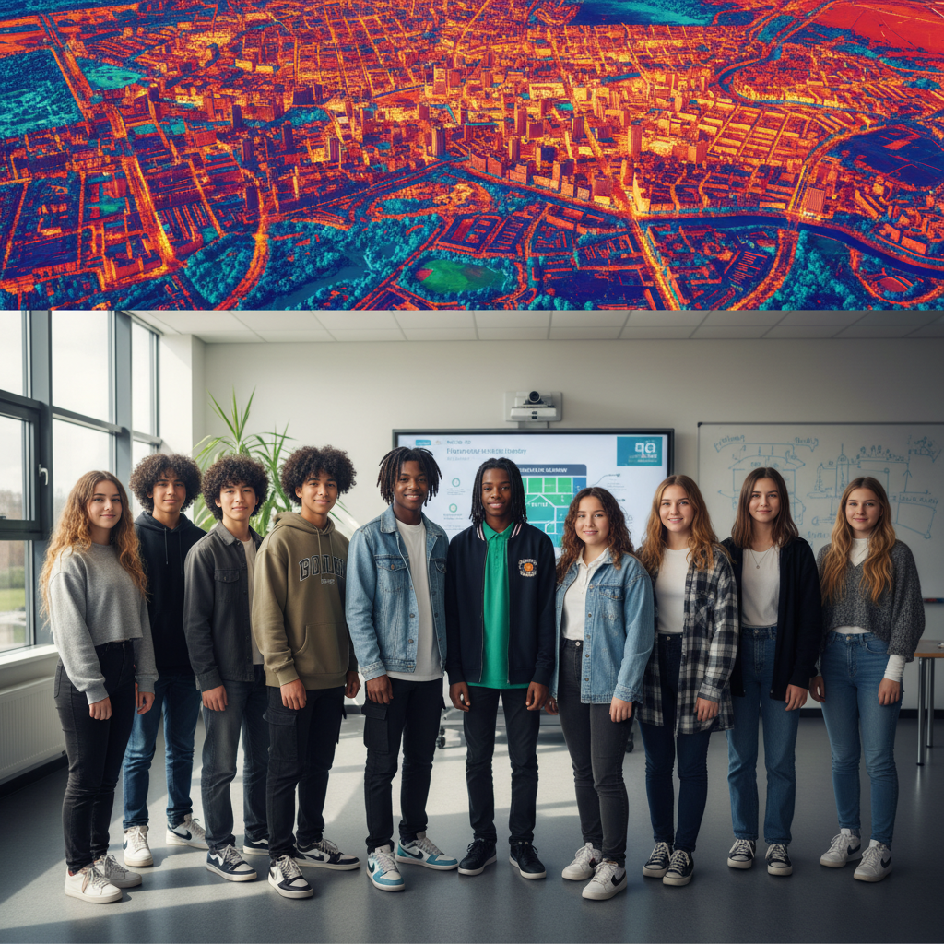
ModelIt!
Student Lesson
Urban Heat Islands: Why Cities Are Hotter Than Forests
Modeling How Built Environments Amplify Extreme Heat
NGSS: HS-ESS3-4, HS-PS3-4
9th Grade — Level 2: Advanced
1/9

Slide 2
What You Will Learn Today
Learning Goals
* Model how impervious surfaces, green space loss, and air conditioning create self-reinforcing urban heat loops
* Analyze how urban heat islands disproportionately affect low-income communities
* Evaluate cooling interventions at different scales from building to city-wide
* Design an equitable urban cooling strategy that targets the most vulnerable neighborhoods
Key Vocabulary
Urban Heat Island
A metropolitan area significantly warmer than surrounding rural areas due to heat-absorbing surfaces, reduced vegetation, and waste heat from buildings and vehicles
Albedo
The reflectivity of a surface; dark surfaces like asphalt have low albedo and absorb heat, while light or vegetated surfaces have high albedo and reflect it
Thermal Mass
The ability of a material to absorb, store, and later release heat; concrete and asphalt store daytime heat and radiate it at night
Environmental Justice
The principle that no community should bear a disproportionate share of environmental hazards due to race, income, or political power
2/9

Slide 3

The Big Question
Why can a city be 10 degrees hotter than the forest just 20 miles away, and who suffers most?
Modeling How Built Environments Amplify Extreme Heat. Today we'll build a MODEL to discover the answer!
3/9

Slide 4

Today We Will Build a Model!
A model helps us understand complex systems!
1. LOCATE
Identify the COMPONENTS (parts) of the system
2. ESTABLISH
Connect them with RELATIONSHIPS (+ or -)
3. VISUALIZE
Build your model in ModelIt!
4. EVALUATE
Run SIMULATIONS to test scenarios
5. REVISE
Improve your model based on evidence
4/9

Slide 5

Activity 1: Sort the Components
Sort these components into EXTERNAL (inputs from outside) and INTERNAL (inside the system):
Your Components:
* Impervious Surface Area
* Green Space Coverage
* Ambient Temperature
* Energy Consumption (AC)
* Air Quality Index
* Heat-Related Health Risk
Think: Which components can we control? Which happen on their own?
5/9

Slide 6
Activity 2: Connect with Arrows
Draw arrows to show HOW components affect each other:
(+) POSITIVE Relationship
When one goes UP, the other goes UP too
(-) NEGATIVE Relationship
When one goes UP, the other goes DOWN
Think About It:
When Impervious Surface Area is high and Green Space is low, what happens to Ambient Temperature? If temperature rises, what happens to AC use? And if AC pumps heat outside, what happens to outdoor temperature? Find the reinforcing loop.
6/9

Slide 7
Activity 3: Run the Simulation!
Test these scenarios in ModelIt!
Wealthy vs. Poor Neighborhood
Compare high green space/low impervious vs. low green space/high impervious -- observe temperature and health disparities
Heat Wave
Increase baseline temperature by 5 degrees -- observe how the urban heat island amplifies the extreme event
Green Infrastructure
Increase Green Space Coverage from 10 to 40 percent -- measure cooling effect across all components
Watch the activity graphs change!
[ModelIt Platform Screenshot - Simulation Results Graph]
7/9

Slide 8
What Did We Discover?
Our Model Showed Us:
* Urban heat islands create a reinforcing loop: heat drives AC use which pumps more heat outside which drives more AC use
* The temperature difference between wealthy and poor neighborhoods can exceed 10 degrees F due to green space inequality
* Air conditioning is both a solution and a cause -- it cools indoor spaces while warming outdoor spaces and consuming energy
* Green infrastructure breaks the reinforcing loop by providing passive cooling through evapotranspiration
Answer: Cities are hotter because dark impervious surfaces absorb solar energy, concrete stores heat and releases it at night, and removing vegetation eliminates natural cooling. This creates a reinforcing feedback loop: higher temperatures drive AC use, which pumps waste heat outdoors, raising temperatures further. The communities with the most concrete and least green space -- typically low-income neighborhoods and communities of color -- experience the worst heat. Environmental justice demands that cooling investments target the most vulnerable, not the most politically powerful.
8/9

Slide 9

STEM Challenge: Design an Equitable Urban Cooling Plan
YOUR ENGINEERING MISSION
Design a neighborhood cooling strategy that prioritizes environmental justice by targeting interventions to the most heat-vulnerable communities.
The Challenge:
A city has funding for urban cooling but limited budget. Some neighborhoods are 10+ degrees hotter than others. Design a plan that allocates cooling interventions equitably based on heat vulnerability, not political influence.
Think Like an Engineer:
* Which neighborhoods should receive cooling interventions first and why?
* What mix of interventions provides the most cooling per dollar?
* How do you balance immediate relief with long-term structural change?
REAL CAREER CONNECTION: Urban Climate Scientists study how built environments modify local weather and design heat mitigation strategies, earning $60,000-$120,000/year at city planning departments, universities, and environmental firms. The skills you're using TODAY are the same ones they use on the job!
9/9

